Slide 1
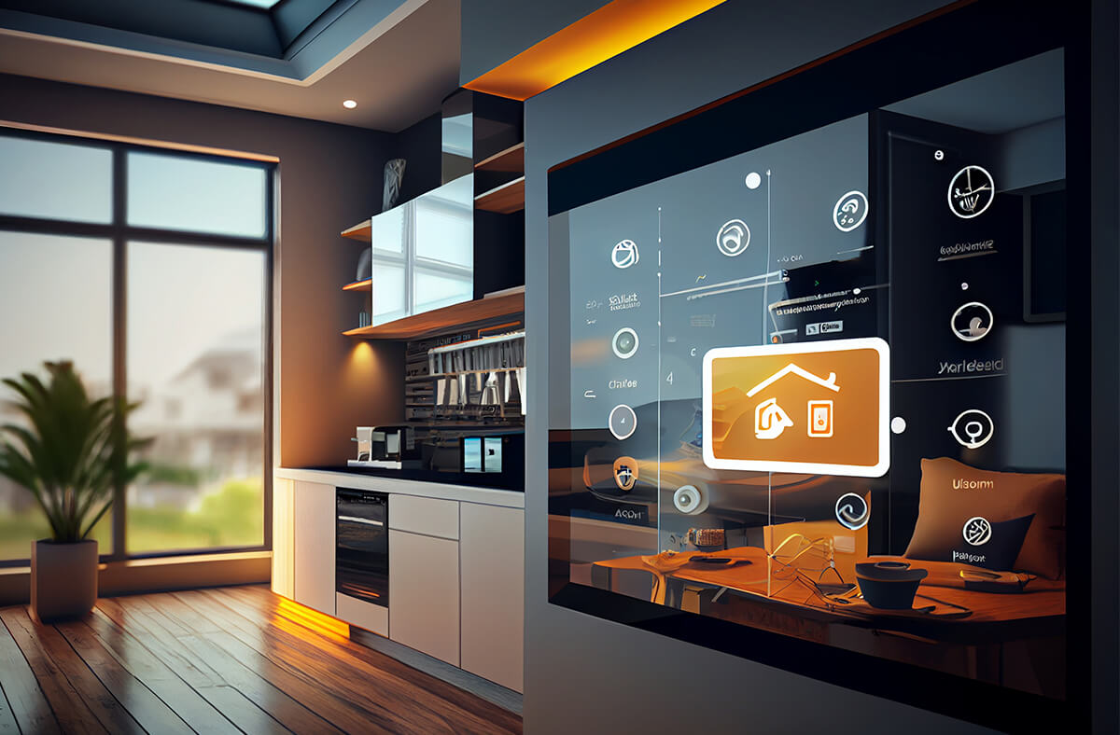
Smart Home Environmental Monitoring System
Izabela Zelek & Chris Leivon

Slide 2
Introduction
Introducing a cutting-edge smart home safety system that combines real-time monitoring with AI-driven automation. This project utilizes ubiquitous computing and machine learning to create a safer, more efficient home environment. The goal is to create a system that enhances home security by combining real-time monitoring with smart home automation

Slide 3
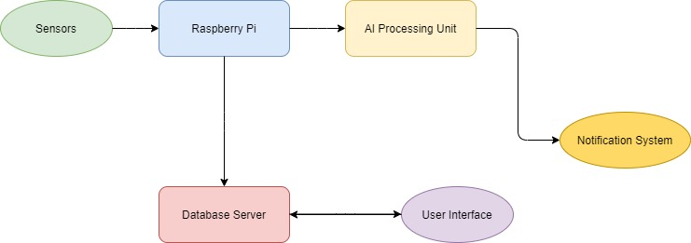
System Overview
1
Environmental Monitoring
2
Machine Learning Integration
Collect real-world data using the Sense Hat sensors on Raspberry Pi.
Use AI to adjust home conditions based on user’s preferences.
3
User Interface
4
Alert System
Web app displays data from the database and allows user interaction.
Color-coded LED alerts and email notifications for safety hazards.

Slide 4
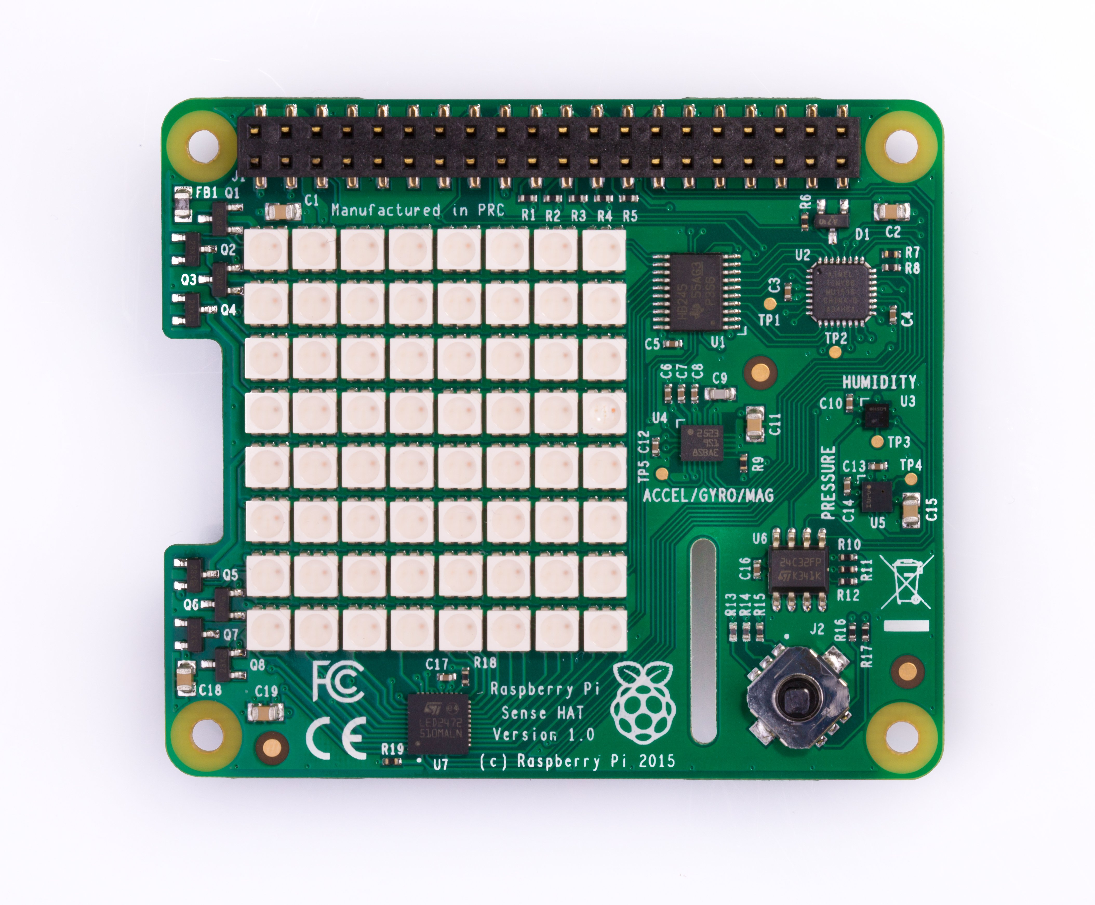


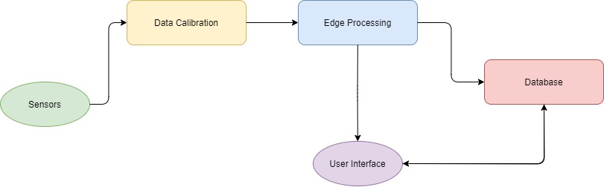

Sensor Integration
Temperature Sensor
Measures ambient temperature with recalibration to account for Raspberry Pi heat.
Humidity Sensor
Detects environmental humidity levels for optimal comfort and safety.
Pressure Sensor
Monitors atmospheric pressure for weather-related insights and predictions.

Slide 5
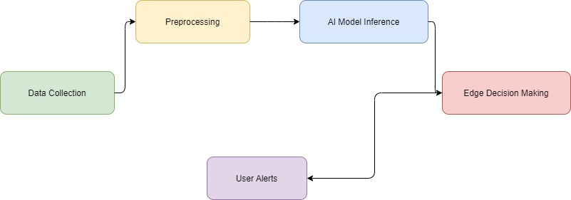
AI and Edge Computing
Random Forest Algorithm
Edge Processing
Data processing on Raspberry Pi for real-time hazard detection and quick responses.
Predicts user preferences for temperature and light intensity based on historical data.
Optimization Strategies
Lightweight models and feature selection to meet computational limitations of Raspberry Pi.

Slide 6





Communication Architecture
Sensor Data Collection
Sense HAT sensors gather environmental data.
MQTT Protocol
Lightweight messaging protocol for IoT device communication.
Database Storage
MySQL database stores sensor data and user preferences.
User Interface
Web dashboard displays real-time data and alerts.

Slide 7
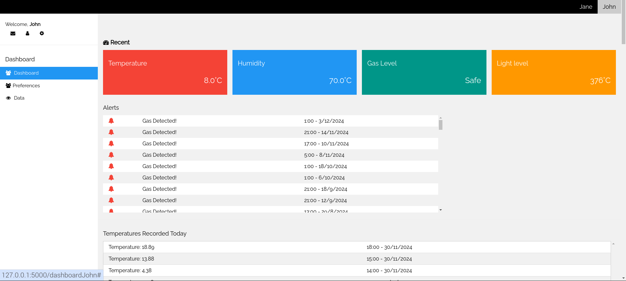
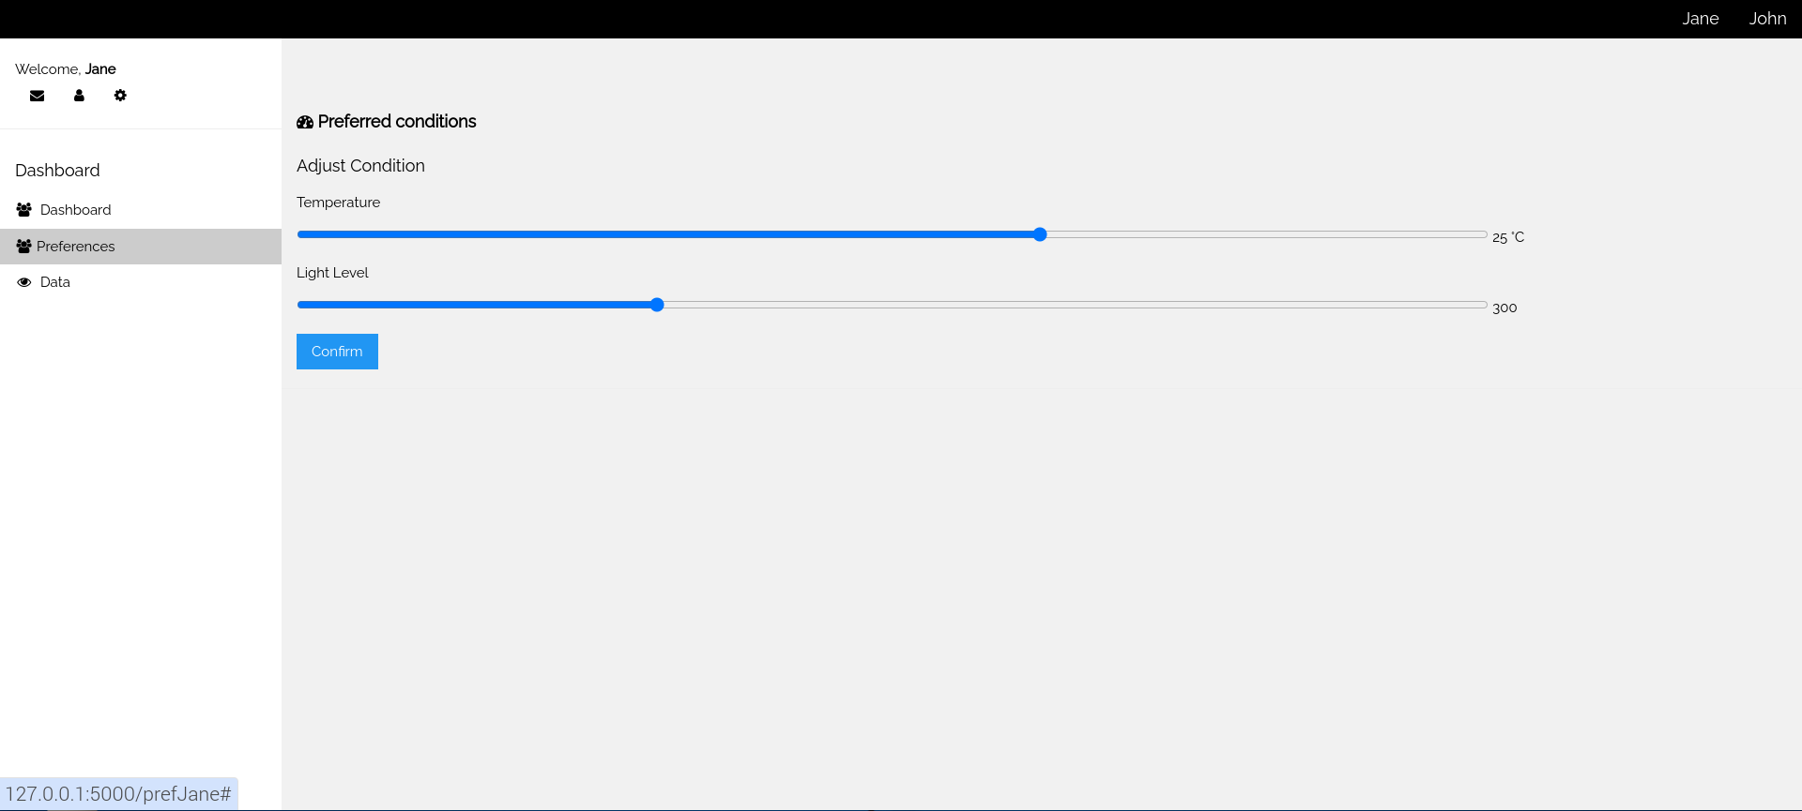
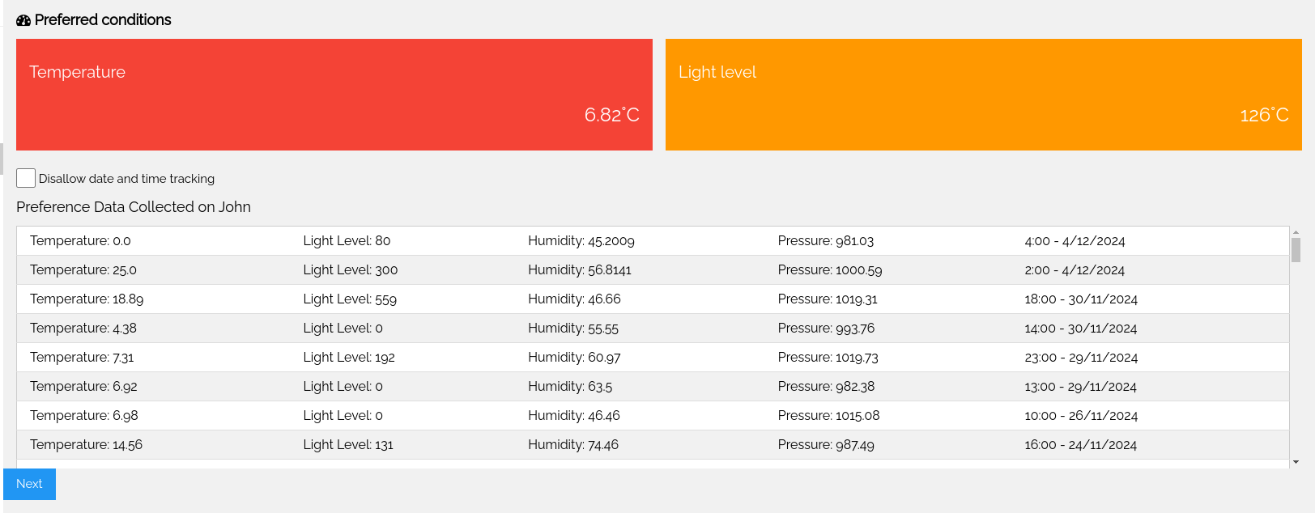
User Interface Design
Dashboard
Preferences
Data Management
Displays current environmental conditions, historical trends, and recent hazard alerts.
Allows users to set temperature and light intensity preferences.
Users can view and delete stored data, enhancing privacy control.

Slide 8

Development Process
1
Sensor Integration
Integrated and calibrated Sense HAT sensors with Raspberry Pi.
2
Database Creation
Set up MySQL database for efficient data storage and retrieval.
3
AI Algorithm Development
Tested and implemented Random Forest for user preference predictions.
4
User Interface Development
Created web dashboard for remote monitoring and user interaction.

Slide 9




Data Security and Privacy
Data Encryption
1
STARTTLS encryption for email alerts and TLS for MQTT communication.
Data Anonymization
2
Only first names stored, other identifying information removed.
Local Processing
3
Data processed on Raspberry Pi to minimize external network exposure.
User Control
4
Options to view, delete, and opt-out of data collection.

Slide 10
Legal Implications and Compliance
GDPR Compliance
Potential Liabilities
System adheres to key GDPR principles including data minimization, transparency, and right to erasure.
Measures in place to address risks of data breaches, false alerts, and system failures.

Slide 11
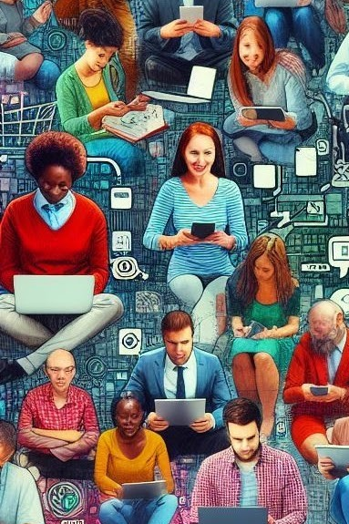



Societal Impact and Accessibility
Inclusive Design
Visual alerts and easy-to-navigate interface cater to diverse user needs.
Privacy Protection
Local data processing and user control over information collection.
Sustainability
Energy-efficient components and features to optimize home energy use.

Slide 12
Key Achievements and Future Improvements
Working Prototype
1
Successful integration of real-time monitoring, user adjustments, and hazard detection.
Machine Learning Model
2
Implemented Random Forest for predicting ideal temperature and light conditions.
User-Centric Design
3
Developed accessible web dashboard with privacy controls.
Future Enhancements
4
Addition of more sensors and integration with smart appliances.

Slide 13
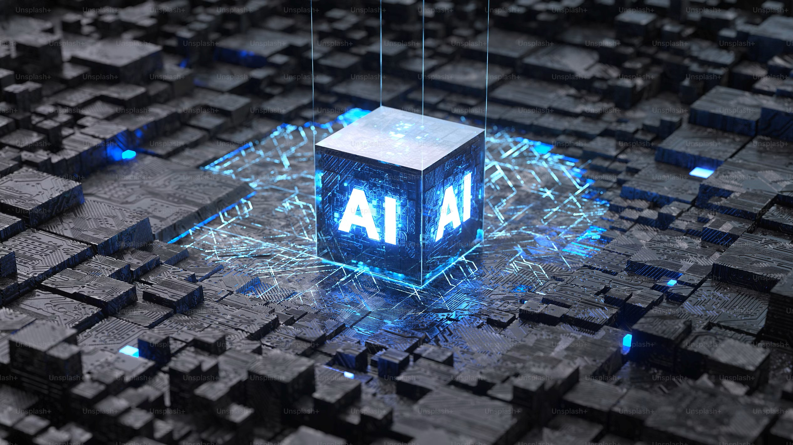
Conclusion and Reflection
Technical Growth
Collaborative Problem-Solving
Gained insights into IoT, machine learning, and edge computing challenges.
Strengthened teamwork skills in integrating hardware, software, and user interface design.
Ethical Considerations
Deepened understanding of responsible technology development and social impact.

Slide 14

THANK YOU
Any Questions?

